Slide 1
MultiMedia
Image
Lets Begin!!!

Slide 2


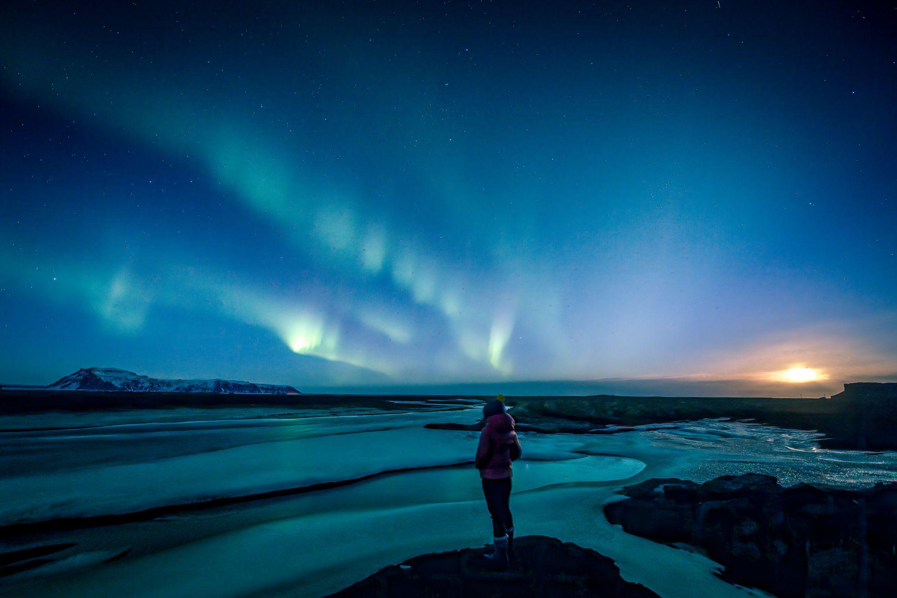
What is an image?
Multimedia Images refers to visual media that can be displayed on a screen or printed on a page.
It can be drawings, photographs, illustrations etc.

Slide 3

Bitmap
Images
Vector
Images
Types of
Images
2D
Images
3D
Images

Slide 4



Bitmap Images
These are also known as Raster Images.
They are composed of Pixels (tiny squares)
They are Resolution Dependent.
Not Scalable
Example: JPEG, BMP

Slide 5
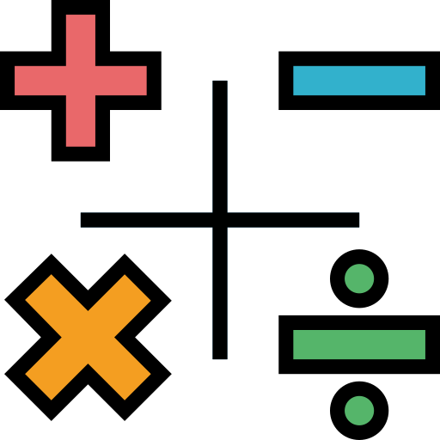


Vector
Images
These are also known as Object Oriented Images.
Made of mathematical equations
They are Resolution Independent.
Highly Scalable
Example: PNG, SVG

Slide 6


Image
File
Extensions

Slide 7






Image Extensions

Slide 8
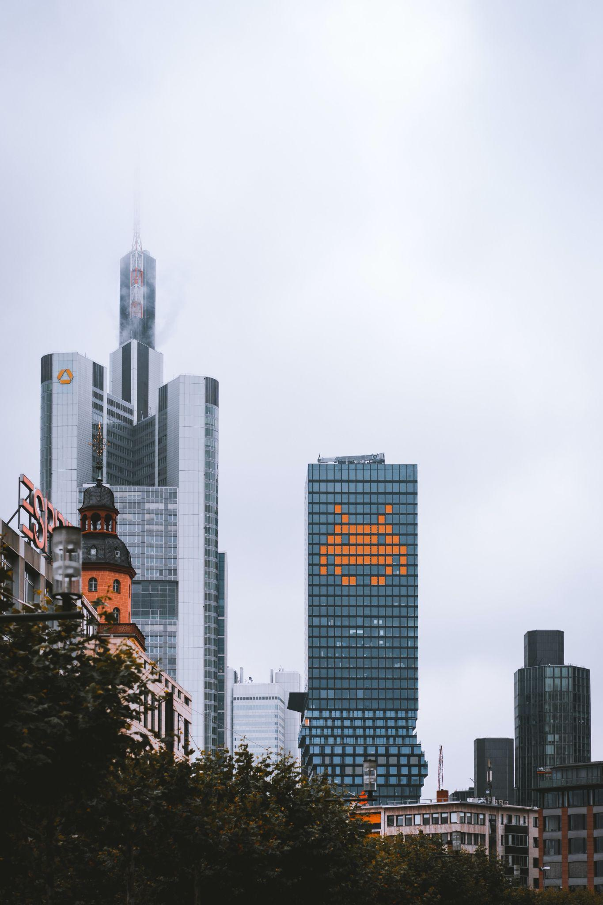
.JPEG
Stand for: Joint Photographic Experts Group
Introduced in 1992
It works on Lossy Compression technique
Has a Larger File Size
Suitable for general purposes

Slide 9



.PNG
Stand for: Portable Network Graphics.
Introduced in 1996.
It works on Lossless Compression technique.
Has a Smaller File Size.
Suitable for Web Development.

Slide 10
.GIF
Stand for: Graphics Interchange Format
Introduced in 1987.
It works on Lossless Compression technique.
Has a Smaller File Size.
It works as a movable image

Slide 11



JPEG
COMPRESSION

Slide 12
What is Compression??
Compression refers to the process of compressing a digital image using various types of compression algorithm.
The algorithms are designed to use the size of a digital image while maintaining a certain level of image quality.

Slide 13
Phases of jpeg
compression
Color Space Conversion
Chrominance SubSampling
Discrete Cosine Transform
Quantization
HuffMan Coding

Slide 14


Color Space Conversion
Color space conversion is the translation of the representation of a color from one basis to another.
It converts the RGB color format to YCbCr format.

Slide 15
Color Space Conversion
RGB
Y (luma):
The Y component represents the brightness (luminance) of the image. It is also referred to as the "luma" component. Y values range from 0 to 255, with 0 being black and 255 being white.
Cb (blue-difference chroma):
The Cb component represents the blue color information of the image. It is also known as the "blue-difference chroma" component. Cb values range from -128 to 127, with 0 being a neutral value.
Cr (red-difference chroma):
The Cr component represents the red color information of the image. It is also known as the "red-difference chroma" component. Cr values range from -128 to 127, with 0 being a neutral value.

Slide 16


Chrominance SubSampling
Chrominance SubSampling refers to reducing the resolution of the chrominance components i.e: Cr & Cb.
(Chrominance refers to the difference between the color being represented on a screen and the actual color of a standard)

Slide 17
Chrominance SubSampling
In chrominance subsampling, the chrominance (color) information is sampled at a lower resolution than the luminance (brightness) information, which reduces the amount of data that needs to be stored.
The most common types of chrominance subsampling used in JPEG compression are 4:2:2, 4:2:0, and 4:1:1.

Slide 18
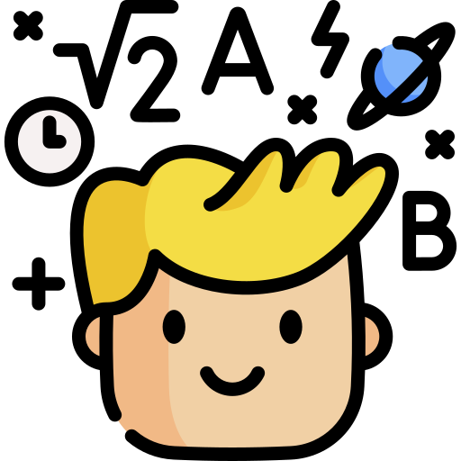


Discrete Cosine Transform
The Discrete Cosine Transform is a mathematical technique in which each block of an image is analysed to gather information.
This data is used for the process of compression

Slide 19
Discrete Cosine Transform
The DCT is a linear transformation that converts a signal from the spatial domain (pixels) into the frequency domain by expressing it as a linear combination of different frequencies. The DCT formula is defined as follows:
X(k) = ∑[n=0 to N-1] x(n) cos[(π/N) (n + 1/2) k]
where x(n) is the input signal, X(k) is the output signal, N is the length of the input signal, and k is the frequency index.

Slide 20


Quantization
The Phase of Quantization comes after the DCT where the frequency data is now rounded off to convert it into the data of smaller size.
The data collected in the previous phase is now reduced so that only the necessary values are kept for the representation of the Image.

Slide 21

Quantization
Quantization is a lossy process, meaning that some information is lost during the process. The level of loss depends on the step size used for quantization.
A larger step size leads to more aggressive quantization and greater data reduction but also results in greater loss of image detail and quality.
132.41453
132

Slide 22


Huffman Coding
It is the final phase algorithm which is used to further compress the quantified DCT values into a compact binary stream of bits
The Huffman Coding is a lossless compression technique.

Slide 23
Huffman Coding
Huffman Coding works on the principle of Greedy Algorithm
The algorithm makes the best decision at each step based on the information available at that point, without considering the impact of the decision on future steps
For example: converting every character of the input stream from its ASCII representation to huffman encoding format for reducing size.

Slide 24


